Slide 1

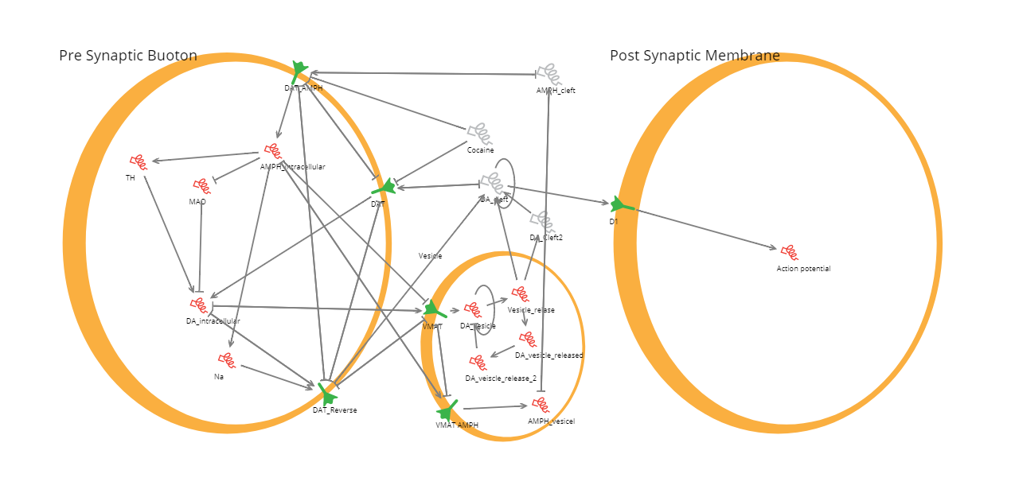
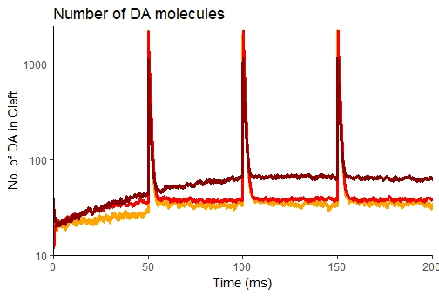
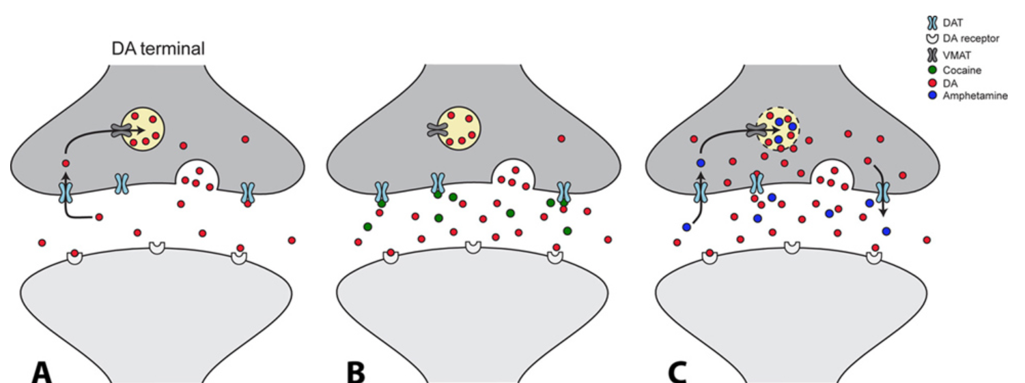
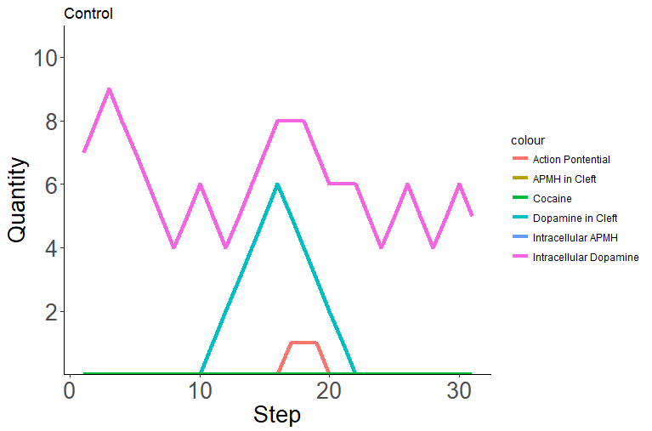
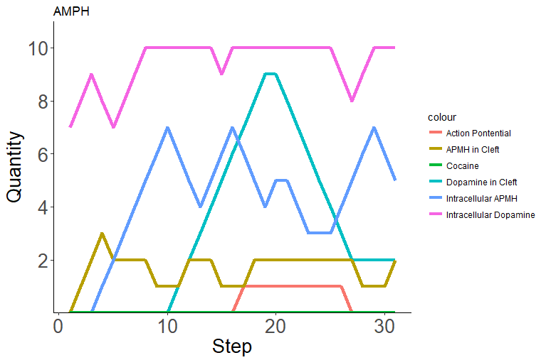
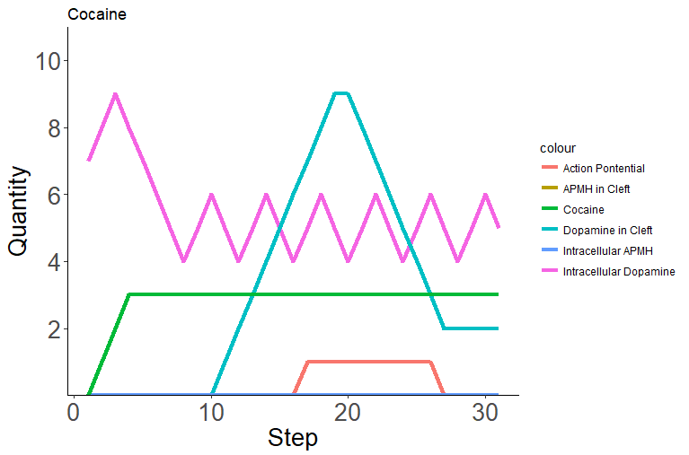
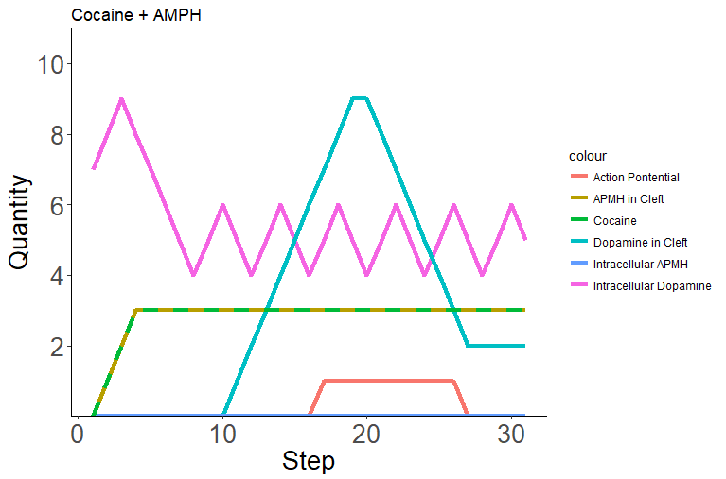
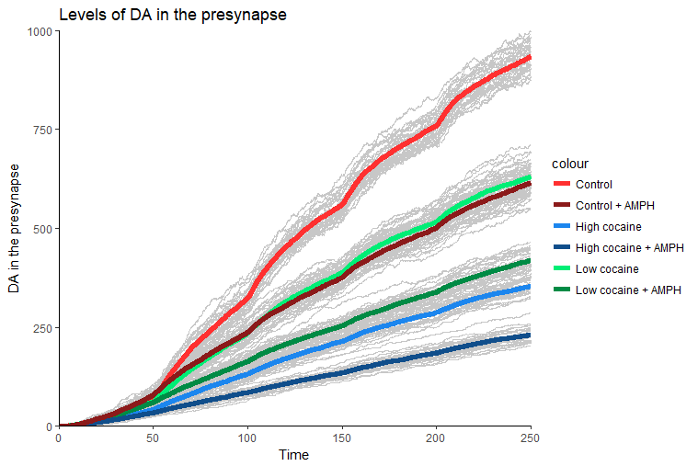
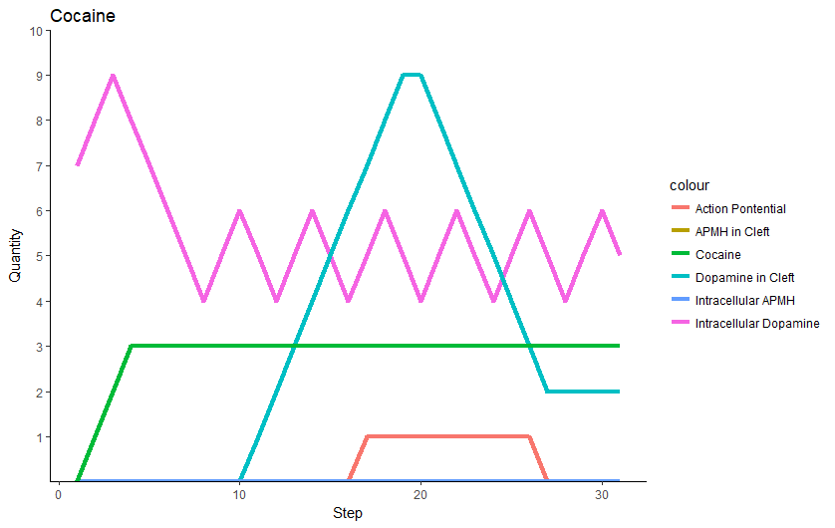
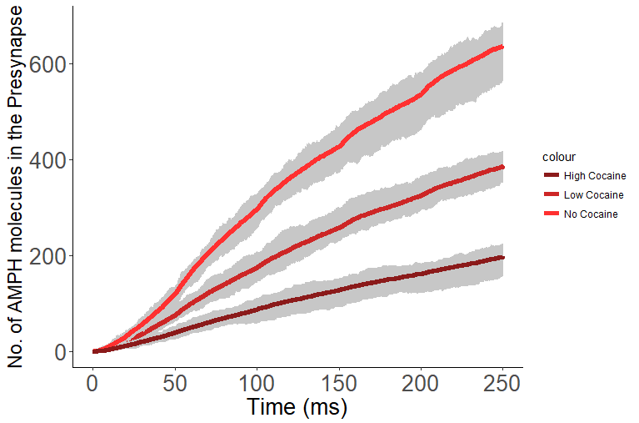
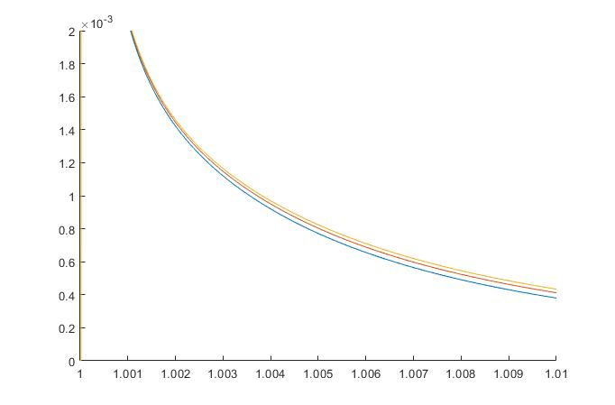
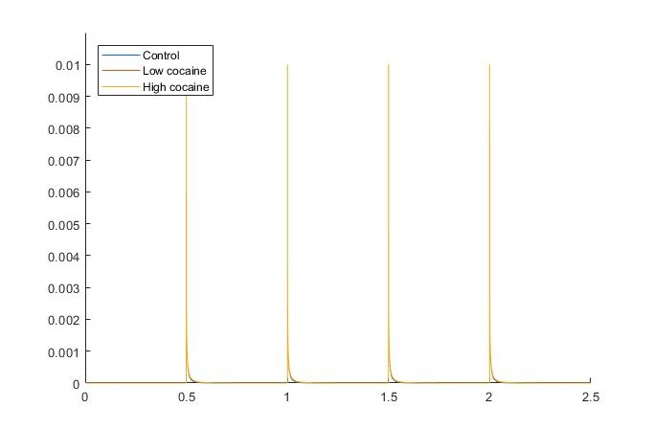
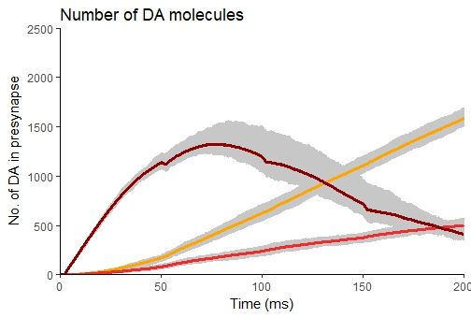



Modelling Addictive Drugs at Striatal Dopaminergic Synapses
Louisa Sober, Gregory Tate, Catrin Lloyd Part III Systems Biology
Introduction
BMA – Qualitative Analysis of Dopaminergic Transmission
Effects of different AMPH levels continued
A detailed mechanism of psychoactive drugs remain elusive with experimental research being challenging due to ethical restrictions. Computational models provide a practical alternative that allow investigation into the mechanisms of addictive drugs.
Cocaine and amphetamine (AMPH) are two commonly abused addictive drugs that both prevent dopamine (DA) uptake by the Dopamine Transporter (DAT) via a non-competitive and competitive mechanism respectively. At high concentrations AMPH also removes DA from the vesical and reverses direction of DAT transport (Fig. 1).
Both AMPH and cocaine increased dopamine levels in the cleft and prolonged the action potential (Fig. 3).
Cocaine inhibits the effects of AMPH by preventing its uptake into the presynaptic bouton.
Limitations: not temporal or quantitative
DA levels in cleft (fig.7):
Low [AMPH] led to slight increase in the free DA in the cleft
High [AMPH] dramatically increased the free DA in the cleft
We have compiled data from the literature to build multiple in silico models in order to study the effects of AMPH and cocaine, both singularly and in combination, at the level of the single synapse.
Figure 3 : BMA results with and without AMPH and Cocaine
A
B
C
D
Figure 7 : DA levels in the cleft with differing [AMPH]
Figure 1 : Schematic of the mechanisms of action of Amphetamine and Cocaine at a dopaminergic synapse
Cocaine inhibits AMPH uptake
Methods
Increasing cocaine reduced the absolute effect of AMPH on dopamine uptake from the cleft. It did not completely abolish the effect of AMPH (fig 8)
Cocaine inhibited AMPH uptake into the presynaptic bouton (fig 9)
MATLAB - A deterministic model of dopamine change in the cleft and for fitting curves to calculate the rate of diffusion out of the cleft.
BMA - A qualitative network of dopamine transmission and the effects of cocaine and AMPH on postsynaptic action potentials
Smoldyn - A stochastic and spatial model of the synapse to simulate the effects of cocaine and amphetamine at different levels.
Python was used for repeating Smoldyn simulations
R was used for plotting the outputs from Smoldyn and BMA.
Figure 4 : BMA results with and without AMPH and Cocaine
(A) Control (no AMPH, no cocaine) (B) AMPH only (C) Cocaine only (D) Both AMPH and Cocaine
Smoldyn – A Spatial and Stochastic Model
10nm
10nm
10nm
Figure 8 (top) : DA uptake in the presynapse with differing levels of cocaine and AMPH
Deterministic Model - DA diffusion and reuptake
Figure 9 (left) : DA uptake in the presynapse with differing levels of cocaine and AMPH
Changes in dopamine concentration were described by equation 1, including terms for diffusion and enzymatic degradation.
Action potentials released dopamine every 500ms.
Cocaine’s effect on re-uptake was modelled by changing $V_{max}$ proportionally to the change in available DAT.
Equation (1) was solved numerically using a finite-difference scheme, an implementation of which can be seen in equation (2), where${ u}_{i}^{j}≔u\left(iΔx,jΔt\right)$.
$$\frac{∂u}{∂t}=D\frac{∂^{2}u}{∂x^{2}}−\frac{V_{max}}{K_{m}+u} (1)$$
$$\frac{u_{i}^{j+1}−u_{i}^{j}}{Δt}=D\frac{u_{i+1}^{j}−2u_{i}^{j}+u_{i−1}^{j}}{{(Δx)}^{2}}−\frac{V_{max}}{K_{m}+u_{i}^{j}} (2)$$
Figure 5 : Stills of a dopamine vesicle release from the presynaptic bouton.
(A) DA molecules are stored in the vesicle at the active zone ready for release. (B) Mid-vesicular release with DA diffusing out of the bouton. Some D1 receptors (blue) on the postsynaptic membrane become bound to DA (cyan). (C) DA = yellow, AMPH = pink, DAT = red, DAT-DA = orange, DAT-AMPH = purple, DAT-COC = maroon, D1 = blue, D1DA = cyan. Scale bar represents 10nm.
Discussion
Conclusions:
Diffusion is the main method of dopamine clearance from the cleft opposed from DAT uptake.
The mechanisms of high [AMPH] are more effective at increasing DA levels in the cleft than just the competitive inhibition of low [AMPH]
Cocaine inhibits AMPH uptake therefore is likely to inhibit the intracellular effects of high [APMH] in the presynapse.
Outlook:
Considering additional contributors that alter dopamine transmission
Increase scale of model both spatially with a multi-synapse system and temporally to consider the build of basal dopamine levels in the striatum
A
B
Effects of different AMPH levels
DA levels in the presynapse (fig.6):
Low concentration of AMPH reduces [DA] in the presynapse by inhibiting DA uptake
High concentration of AMPH initially increases [DA] as DA is partially excluded out the vesicle. DA concentration then decreases due to the effect DAT reversal and inhibited DA uptake
Summary
We created deterministic, qualitative and stochastic spatial models to show that AMPH and cocaine
Figure 2 : 1D model DA levels in the cleft over time
Over five dopamine releases
Zoomed in version of the second dopamine release at 1ms
Figure 6 : DA uptake in the presynapse with differing AMPH concernrations.
REFERENCES!!!!!!!!!!!!!!!!!!!!!!!!!!!!!!!!!!!!!!

Slide 2
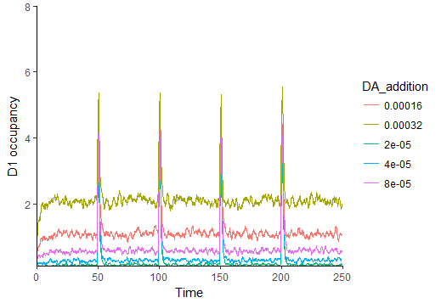
Figure 5 : Stills of a dopamine vesicle release from the presynaptic bouton.
(A) DA molecules are stored in the vesicle at the active zone ready for release. (B) Mid-vesicular release with DA diffusing out of the bouton. Some D1 receptors (blue) on the postsynaptic membrane become bound to DA (cyan). (C) DA from the release has been either taken up into the presynaptic bouton or diffused out of the cleft
DA = yellow, AMPH = pink, DAT = red, DAT-DA = orange, DAT-AMPH = purple, DAT-COC = maroon, D1 = blue, D1DA = cyan. Scale bar represents 10nm.
Figure 6 : Basal level of Dopamine leading to changes in D1 occupancy
CHANGE THE ORDER OF THE LINES!!!!!!!!!!!!!!!!!!!!!

